Slide 1
Growth Foci Concept for Regional Development
By - R. P. Mishra
Dr. Kaustuv Mukherjee
Asstt. Prof. in Geography
Chandidas Mahavidyalaya

Slide 4
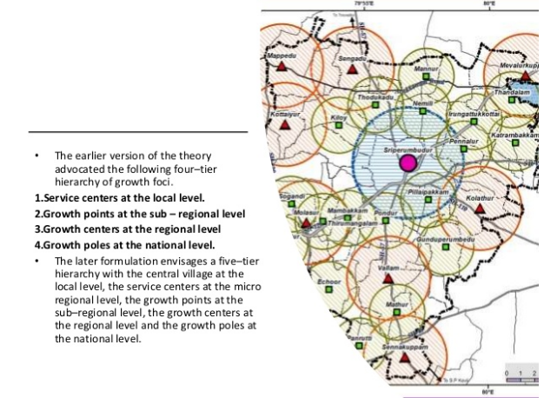
Four Tier Hierarchy of Growth Foci

Slide 5
Five Tier Hierarchy of Growth Foci in Modified Version
Growth Pole
Growth Centre
Growth Point
Service Centre
Central Village

Slide 6
Centralized
Decentralized
Distributed

Slide 9
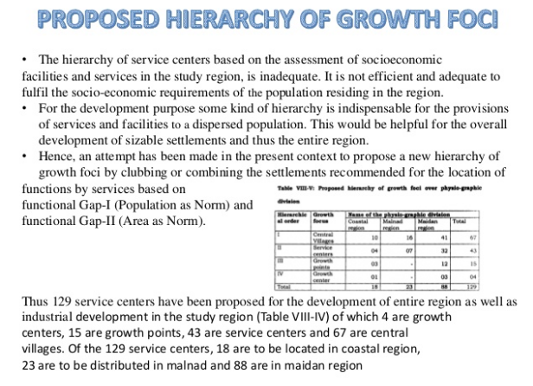

Slide 10
Thank You

